Slide 1



Must Have
The Real Reasons We Need a Smart Grid for the 21st Century Grid
presented to: i – PCGRID Workshop – 2012 San Francisco, CA March 28, 2012
^
by:
Merwin Brown,
Director
Electric Grid Research

Slide 2
We begin our story by observing past changes in key factors of the T&D community.
“~2050?”
“Yesterday” – 1890s to 1960s
Role: The Physical Link: Generator to the Meter under a Regulatory Compact
Operation: Deterministic & Planned
Form: Mostly Radial, Grew in Bulk more than Intelligence
Key Success Factor: Reliability
Time Line

Slide 3
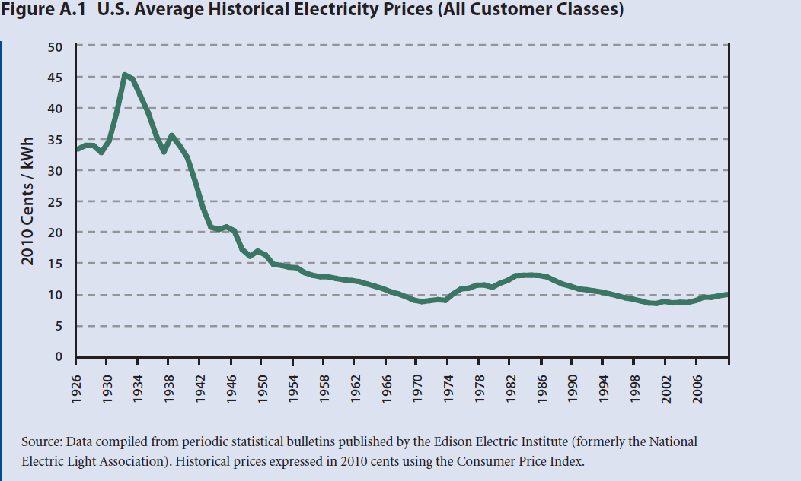
The avg. real price of electricity fell until the early 1970s. Demand grew at about 8% per year.
U.S. Average Historical Electricity Prices (All Customer Classes)
Source: “The Future of the Electric Grid, An Interdisciplinary MIT Study, Appendix A: A Brief History of the U.S. Grid,” 2011 Massachusetts Institute of Technology, p 237
Declining prices were due largely to economies of scale in unit size as new plants were built to meet demand.
3

Slide 4

The success factors involved in investment decisions were few, the equation simple.
f(reliability) ~ G (utility-scale) + [T(utility) + D (utility) ]_{minor}
Where:
  f = investment decision
  G = electric generation
  T +D = transmission and distribution capacity
The big decision was choosing the next power plant.
4

Slide 5
Several events and trends in the ‘60s and ‘70s set the stage for change.
‘62: Eastern Interconnection was established, followed by the northeastern blackout of ‘65 , followed by creation of North American Electric Reliability Council (NERC)
Implications:
  An “unseen” local outage somewhere else could cause a wide-spread cascading blackout putting your utility customers in the dark.
  The stage was set for increasing attention to operating standards for the grid.
‘62-’63: Rachel Carson, “The Silent Spring” series
Implications:
  Environmental impact became an additional factor in selecting, siting and permitting new infrastructure, generally leading to longer construction schedules.
  The external costs of environmental protection began to be “internalized” in the cost of electricity.
Continued on next slide
5

Slide 6
Several events and trends in the ‘60s and ‘70s set the stage for change. (Continued from previous slide)
‘73: First oil embargo
Implications
  After almost 40 yrs of essentially flat prices and no volatility, fuel prices and price volatility rapidly increased.
  This factor influenced federal government to open the door to non-utility generation, and alternative energy sources.
‘78: Public Utility Regulatory Policies Act (PURPA)
Implications
  It forced utilities to contract with non-utility generators to buy electricity at “avoided cost,” which in some cases unintentionally increased the price of electricity.
  It introduced variable renewable generation into the electric grid.
Continued on next slide
6

Slide 7
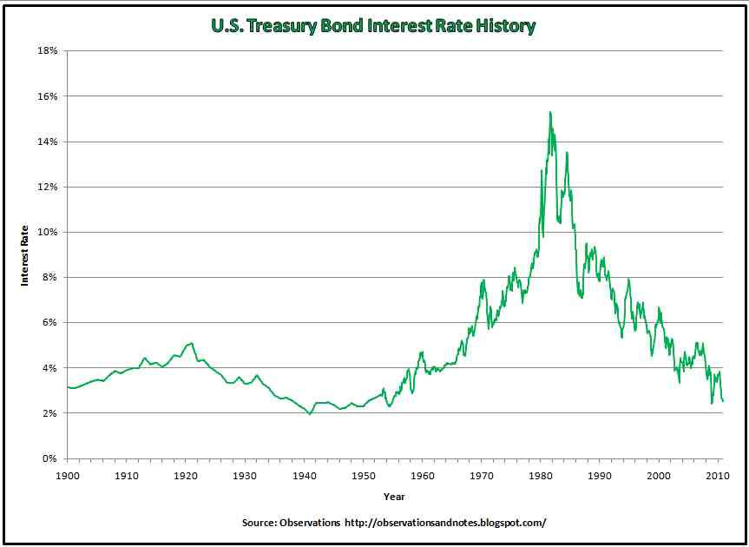
Several events and trends in the ‘60s and ‘70s set the stage for change. (Continued from previous slide)
‘60 – ’70 saw unprecedented rise in interest rates, in part causing “$1 billion” nuclear plants to cost “$5 billion.”
Big power plant projects with long schedules became expensive. Economy of scale in unit size lost its punch.
7

Slide 8
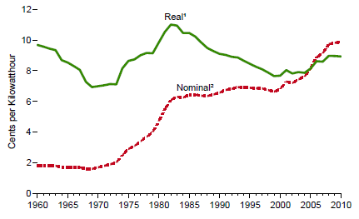
After 2 decades of falling prices, in the early ‘70s the real price of electricity sharply increased.
U.S. Average Historical Electricity Prices (All Customer Classes)
Source: U.S. Energy Information Administration / Annual Energy Review 2010, pp-268-269
For the first time in decades, increased “reliability” came with an increase in the unit price for electricity.
8

Slide 9
The growing tension between reliability and unit price of electric service led to a growing tension among ratepayers, regulators and utilities.
Customers complained about higher rates.
Growth in electric demand begin to fall off.
Regulators thought about disallowing, or did disallow, rate recovery for some large utility plant investments.
Some said that the “regulatory compact” was broken.
Academics and policy makers began to talk about a new power system model based on wholesale competition.
Utilities became unsure and cautious about making new investments.
9

Slide 10
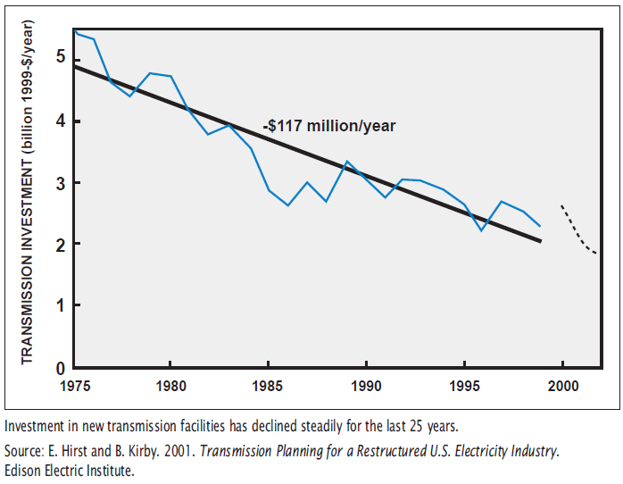
Investment in new transmission went into a steady decline for 25 years.
Source: Source: E. Hirst and B. Kirby. 2001. Transmission Planning for a Restructured U.S. Electricity Industry. Edison Electric Institute. http://www.ferc.gov/industries/electric/gen-info/transmission-grid.pdf
Transmission System Investment over Time
Transmission capacity growth rate fell behind the rate of growth in demand.
Daily transmission constraints or “congestion” increased electricity costs and the risk of blackouts.
10

Slide 11
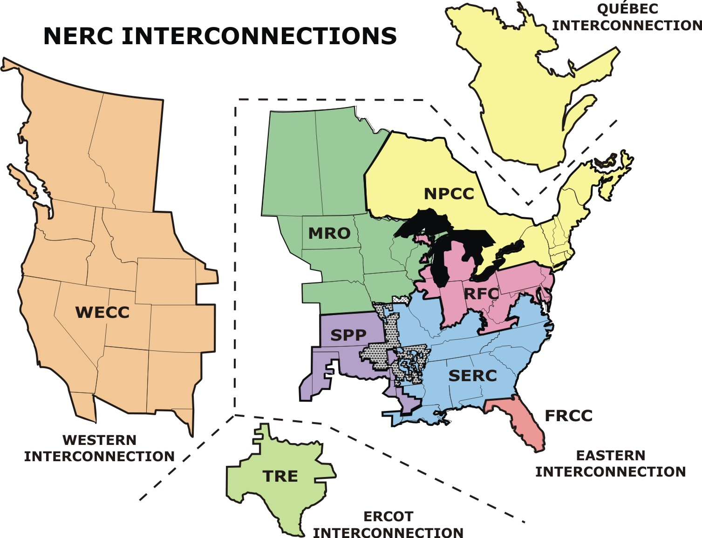
The power system became increasingly dependent on large interconnections to improve reliability and lower costs, but at a price.
Underinvestment reduced the operating margins.
Limited to local information, grid operators had limited wide-area situational knowledge, often too late.
Local outages could, and did, lead to massive wide-spread blackouts.
Operators needed more infrastructure, or better situational information and controls, or both.
11

Slide 12
Advances in generation technologies improved the economics for small unit sizes.
1930
Optimal generation plant size for a single plant based on cost per megawatt [MW], 1930-1990
Source: Charles E. Bayless, “Less is More: Why Gas Turbines Will Transform Electric Utilities.” Public Utilities Fortnightly 12/1/94
1950
Avg. Generation Cost, $/MW
1970
1980
1990
50
200
600
1,000
Plant Size, MW
Generator ownership was becoming feasible for smaller companies and electric customers.
12

Slide 13

Following other countries’ lead, the U.S. attempted deregulation and competitive wholesale power markets in the ‘90s.
In ‘96, FERC Order No. 888 granted equal transmission access to utility and non-utility generators.
In ’98, California established a wholesale power market, with a limited retail access “experiment.”
Dramatic price increases and blackouts in California in 2000 and 2001 rendered this deregulation attempt as an unintentionally flawed grand experiment.
Wholesale markets continued in many places, but the enthusiasm for totally competitive electric markets waned.
An Assertion: Without participation at the retail level, competitive electric markets’ effectiveness is limited.
13

Slide 14
Over this period electric customers changed too.
Customers became more “electrified.”
The behavior of the load became less “resistive/inductive” and more “electronic.”
Beginning to buy electric vehicles and their own generators.
Load modeling became less accurate and load behavior more uncertain to the grid operator.
14

Slide 15
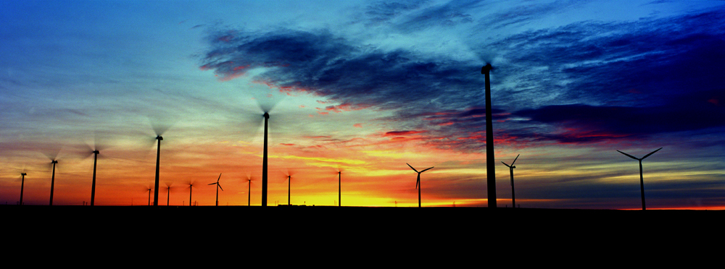

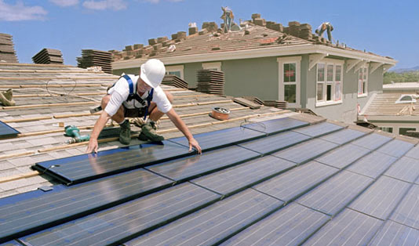
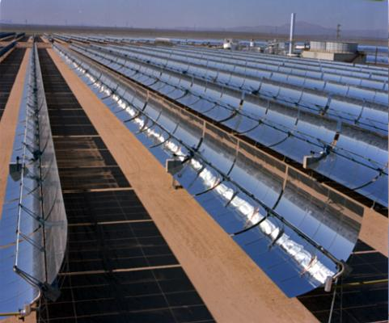
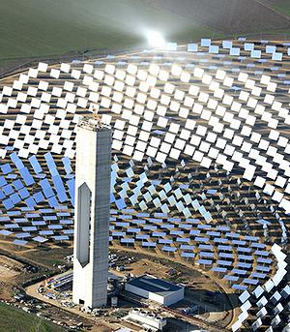
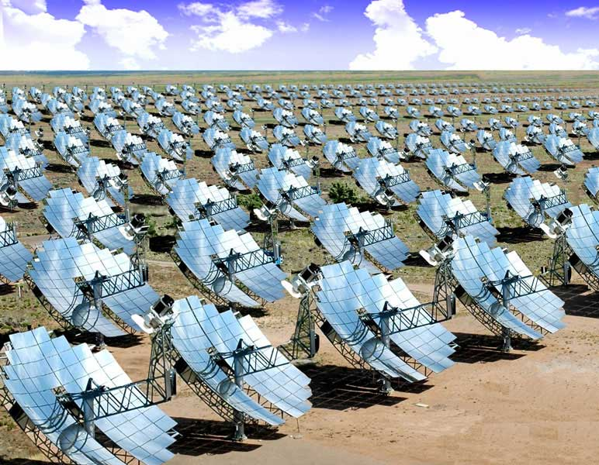
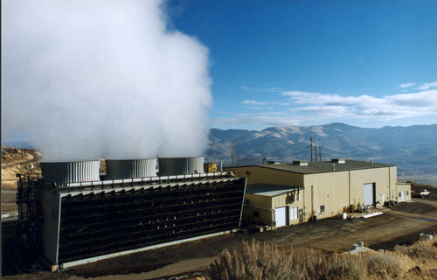
We are seeing more of this…
Biomass
Wind
Solar
It is mostly variable wind and solar resources.
Geothermal
15

Slide 16
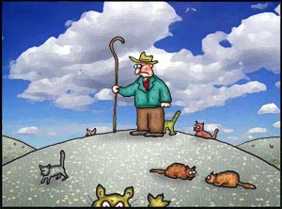
To grid owners and operators, renewable generation looks more like this…
To better understand, let’s explore…
The Saga of Renewable Generation and Grid Integration.
16

Slide 17

The Saga of Renewable Generation and Grid Integration
Most central station renewable generation will be located remote from customers.
.
.
.
.
.
.
.
.
.
.
.
.
.
.
.
.
.
.
.
.
.
.
.
Get Access
Building new transmission lines is becoming increasingly difficult and taking longer.
Renewable Power Plant
HIGH WINDS
17

Slide 18
Continuing The Saga of Renewable Generation and Grid Integration
Some renewables exhibit unique behaviors, for which the grid was not designed and the operator is ill equipped.
.
.
.
.
.
.
.
.
.
.
.
.
.
.
.
.
.
.
.
.
.
.
.
Grid must accommodate.
Some unique behaviors are:
Variability & Unpredictability
Fast Ramp-Rates
Over Supply
Low Inertia
Renewable Power Plant
18

Slide 19
Continuing The Saga of Renewable Generation and Grid Integration
Existing infrastructure is constrained.
.
.
.
.
.
.
.
.
.
.
.
.
.
.
.
.
.
.
.
.
.
.
.
Some Reasons:
Difficulties Building New or Upgrading Transmission
Thermal Limits
Stability Constraints (Voltage, Transient, Dynamic)
“N-1” Contingencies
Renewable Power Plant
Grid capacity must be increased.
19

Slide 20


Continuing the Saga of Renewable Generation and Grid Integration
At the distribution end of the grid, distributed generation integration and new loads offer a significant class of challenges…
.
.
.
.
.
.
.
.
.
.
.
.
.
.
.
.
.
.
.
.
.
.
.
Grid must accommodate DG.
Renewable Power Plant
… And renewable DG integration and EV charging add to the complexity.
20

Slide 21
So, for most of the 20th Century, the electric grid had a relatively simple role: moving electricity from central power plants to the consumers.
e⁻
e⁻
e⁻
e⁻
Its behavior was predictable, operation was largely deterministic, and an operator was in control.
21

Slide 22
But the electric grid owner/operator entering the 21st Century faces:
A growing tension between reliability and cost
Infrastructure strained to the limits
Increasing difficulty in siting and permitting new infrastructure
The threat of extremely expensive and disruptive wide-area blackouts, and increased enforcement of operations standards.
Accommodating the uncertainty of markets in planning and operation, and a growing and changing electric customer base.
Complying with economic and public policy pressures, especially concerning environmental impacts and regulations, increased use of renewable generation, and protecting grid security and customer privacy.
These add up to growing uncertainty, complexity, inadequacy, conflict, and need for flexibility, robustness, real-time situation awareness, probabilistic forecasting and rapid response.
22

Slide 23
In the 21st Century, the success factors involved in investment & operating decisions will be many.
f(reliability vs. price) ~ G(utility, non-utility, imported, customer, renewable)+ T(utility, merchant, interconnection. dynamic control) +D(utility, dynamic control, microgrid) + E(customer, grid, generation) + S(utility-scale, distributed)
+ DR
Where:
  f = investment decision; G = electric generation capacity or energy; T+D = transmission and distribution capacity; E = energy efficiency; S = energy storage; DR = demand response
There will be no one big decision, rather there will be many, requiring unprecedented intelligence.
23

Slide 24
There are essentially two options for successful expansion and operations of T&D:
The traditional “build” solutions, i.e., investments in wires, towers, poles and power plants, and…
.
.
.
.
.
.
.
.
.
.
.
.
.
.
.
.
.
.
.
.
.
.
.
…Improved or new T&D functions to make expansion and operations easier and less costly.
Renewable Power Plant
Success Factor is Societal Acceptance.
Success Factor is New Technologies.
24

Slide 25
Assertions: Perhaps for now we can “build” our way out of these problems, but soon…
…traditional “build” solutions, i.e., investments in wires, towers and power plants, can’t do it alone.
New technologies will be needed to make planning, siting, building and operating easier and less costly…
…especially technologies that make the grid smarter.
25

Slide 26
The smart grid is the joining of two infrastructures:
Electrical
Infrastructure
“Intelligence” Infrastructure
Technologies come in many flavors of hardware, software, analytics and communications.
26
Notes:
26
What is the Smart Grid?
The Merging of the Electrical Infrastructure with an Intelligence Infrastructure

Slide 27
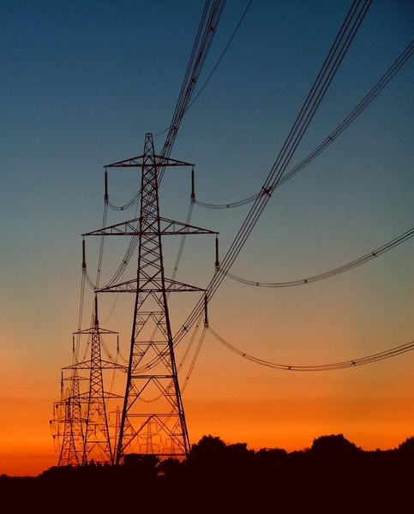
Putting New Power Lines in a Better “Light”
Aesthetics - Reduce or eliminate T&D visual footprint
  Compact Corridors
  Underground Transmission
  Distributed Renewables & Demand Response
Values - Improve the benefit/cost via more knowledge, insight and transparency
  Web-based Interactive Stakeholder Siting Tools
  Cost Allocation & Strategic Benefit Analysis Tools
Access
27

Slide 28

A Smarter, More Flexible Grid
Situation Awareness
  Wide-Area, Real-Time Monitoring
  Visualization
  “Smart Meters”
  Telemetry
Planning & Forecasting
  Solar and Wind Forecasting Tools
  Generator and Load Modeling
  Statistical/Probabilistic Planning Tools
Control
  Energy Storage (temporal power flow control)
  Ancillary Services Devices
  Advanced Power Electronics
  Advanced Intelligent Protection Systems
  Demand Response
  Distributed Generation (non-variable, variable)
Accommodate
28

Slide 29
Optimizing the Grid for Greater Power Flow
Control
  Energy Storage
  Power Flow Control (spatial)
  Ancillary Services Devices
  Advanced Intelligent Protection Systems
  Advanced Fast, High-bandwidth Communications and Computations
  Demand Response
  Distributed Generation
Physical Plant
  Advanced Transmission Line Conductors and Designs
  Advanced Grid Components
  Fault Current Controllers
Capacity
Situation Awareness
  Dynamic Thermal Ratings
  Wide-Area, Real-Time Monitoring
  Visualization
  “Smart Meters”
Planning & Forecasting
  Statistical & Probabilistic Planning Tools
29

Slide 30



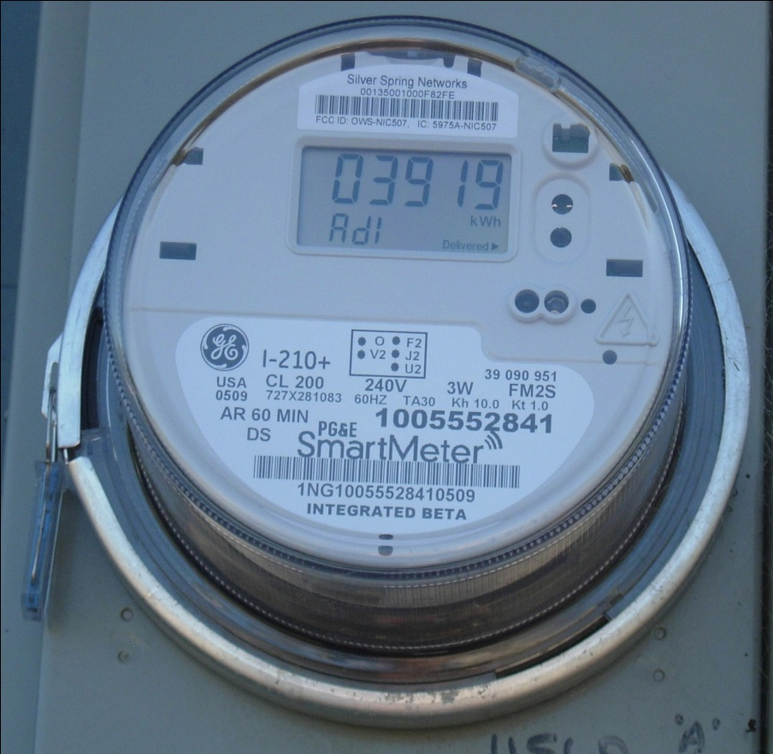
Conclusion: The smart grid is a necessity, not an option, for the 21st Century!
Source: ClipPix ETC is copyright © 2011-2012 by the University of South Florida. http://etc.usf.edu/clippix/
Source: Facial Expressions
Suspicious by lucipaz, http://www.photographycorner.com/galleries/showphoto.php/photo/17376
But not all customers are convinced it is in their best interest.
30

Slide 31
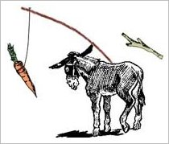
In the end, there are 2 options for getting customer consent: The Carrot or the Stick
The “stick,” in the form of law and regulation, is probably not the preferred way.
The “carrot,” in the form of customer benefits, is probably preferable.
But if the “carrot” cannot easily be delivered soon, don’t lead the customer on with overstated promises.
Honesty is probably the best policy; so tell it like it is.
31

Slide 32
For additional information or discussion, contact :
“People tend to overestimate what can be accomplished in the short run but to underestimate what can be accomplished in the long run.” Arthur C. Clarke
  Merwin Brown
  Director, Electric Grid Research
  Voice: 916-551-1871
  Merwin.Brown@uc-ciee.org
And he’ll find someone to help you.
  Or better yet, visit CIEE’s website: www.uc-ciee.org
32

Slide 33
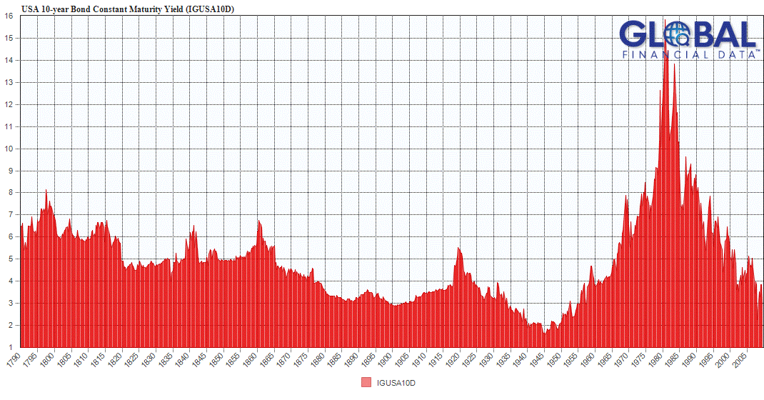
Historical interest rates.
By Barry Ritholtz - August 27th, 2010
This chart of 10yr Treasury yields since 1790 is from Doug Kass at Real Money
33

Slide 34
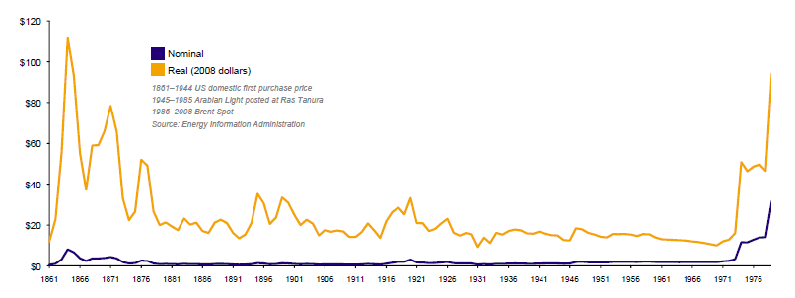
Historical Oil Prices
http://en.wikipedia.org/wiki/1973_oil_crisis
34

Slide 35
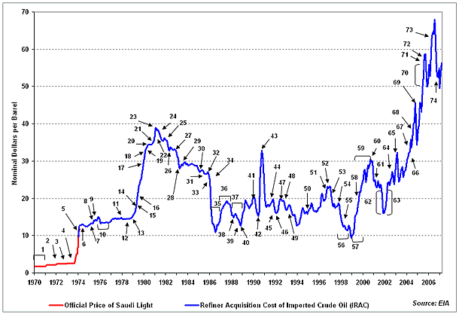
Oil Price History
http://en.wikipedia.org/wiki/1973_oil_crisis
35

